Slide 1
NATIONAL CITY BANK
PROPENSITY MODEL FOR BANK OFFERS
RAHUL GHOSH

Slide 2

AGENDA
Introduction
Data
EDA
Modelling Techniques
100 Customers list
Conclusion

Slide 3

Data
Current Customer Marketing Results
Household Axiom Data
Household Credit Data
House Vehicle Data
Prospective Customers

Slide 4
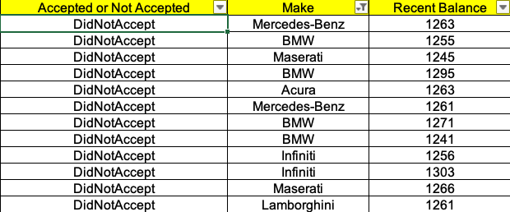
EDA ABOUT DATA – LUXURY CARS
Customers with Luxury cars tend to reject offer

Slide 5
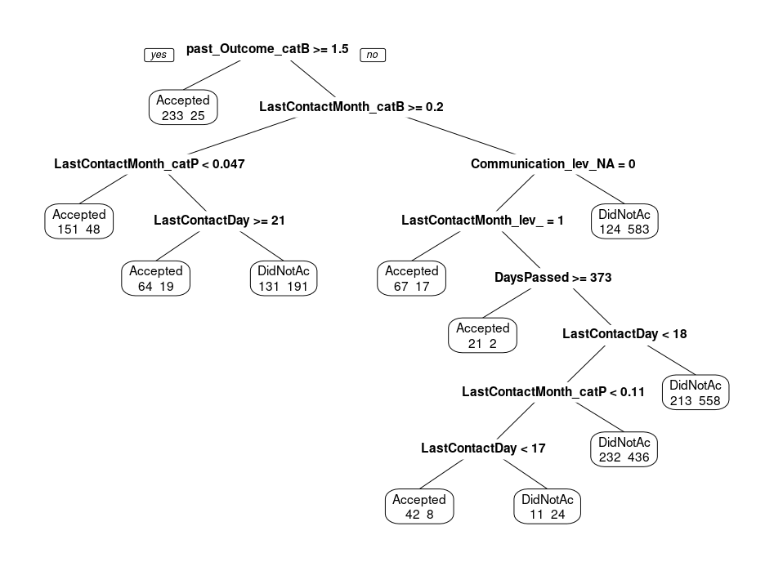
Modelling Techniques
Decision Tree – Pruned Tree

Slide 6
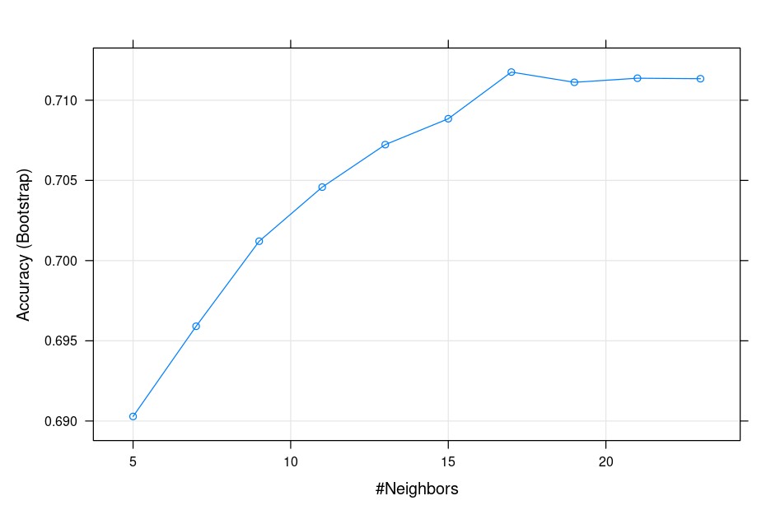
Modelling Techniques
KNN – K-Nearest Neighbor

Slide 7

Modelling Technique
Random Forest
Random Forest 3200 samples
27 predictor 2 classes: 'Accepted', 'DidNotAccept’
Summary of sample sizes: 3200, 3200, 3200, 3200, 3200, 3200, ... Resampling results:
Accuracy 0.7237851
Kappa 0.3867968

Slide 8
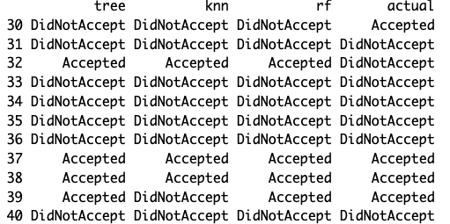
Modelling Predictions Between Actuals

Slide 9
ACCURACY BETWEEN TRAINING AND VALIDATION DATA
ACCURACY FOR TRAINING SET BETWEEN 3 MODELS
Tree : 0.74
KNN: 0.75
Random Forest: 0.74
ACCURACY FOR VALIDATION SET BETWEEN 3 MODELS
Tree : 0.70
KNN: 0.70
Random Forest: 0.72

Slide 10
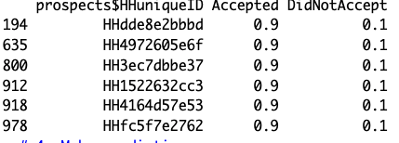
ADDING DATA – PROSPECTIVE CUSTOMERS TO ORIGINAL DATA TO LIST TOP 100
Listing only a portion of the top 100 customers

Slide 11
CONCLUSION
Any Questions ?

